Slide 1
Introducing Agent Development Kit
By Rana D

Slide 2
Purpose of ADk
Purpose of ADK: Simplifies the creation of production-ready AI agents, including multi-modal and multi-agent systems.
Design Principles:
Model-agnostic and deployment-agnostic (works across different AI models and environments).
Interoperable foundation, making agent development feel like traditional software development.
Native support for multi-modal streaming.
Built-in UI for local debugging.

Slide 3
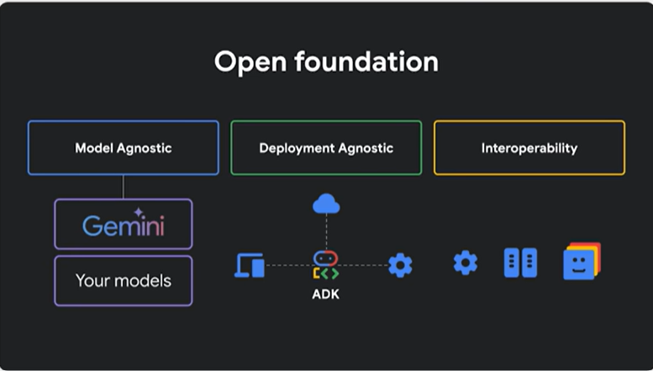
What is that?

Slide 4
Resource
(330) Introducing Agent Development Kit – YouTube
GitHub - google/adk-samples: A collection of sample agents built with Agent Development Kit (ADK)
Resources: Get Started → https://google.github.io/adk-docs Sample Agents → https://goo.gle/3Rbdo4s Subscribe to Google for Developers → https://goo.gle/developers

Slide 5
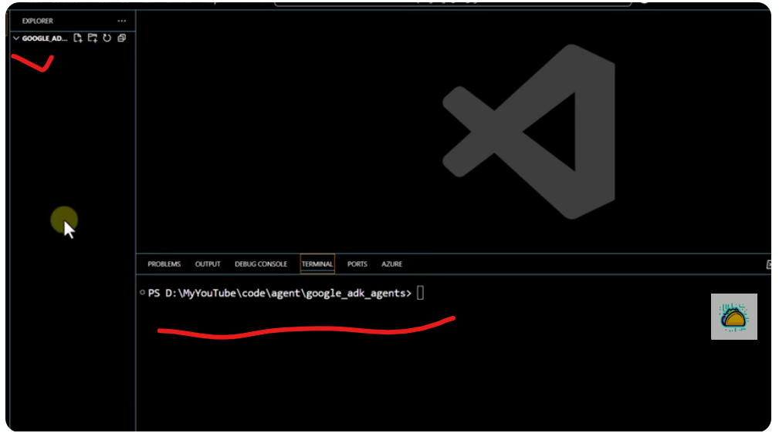
Env Setup and create my first Agent

Slide 6
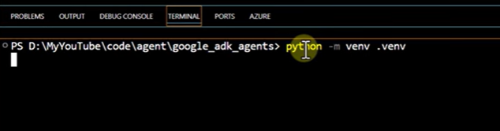

Virtual Env

Slide 7
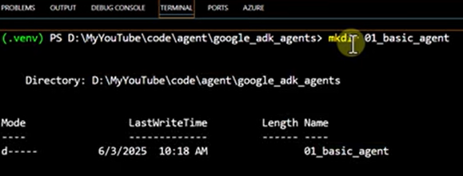
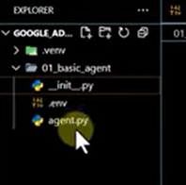
Subfolder creation
Pip install google.adk

Slide 8
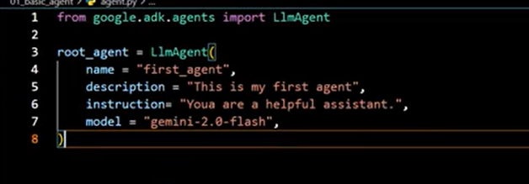
Gemini Developer API | Gemma open models | Google AI for Developers

Slide 9
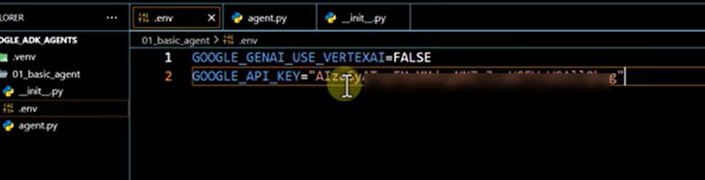
Api key

Slide 10
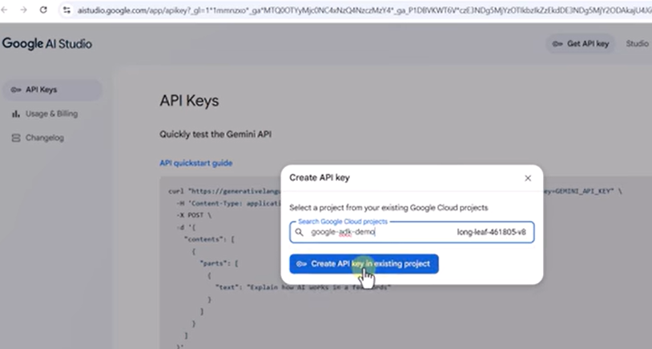
Api key and Google Cloud Account
https://aistudio.google.com/
Create google Cloud project
https://console.cloud.google.com/

Slide 11
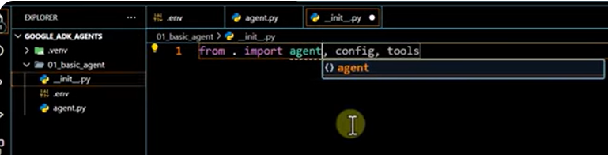
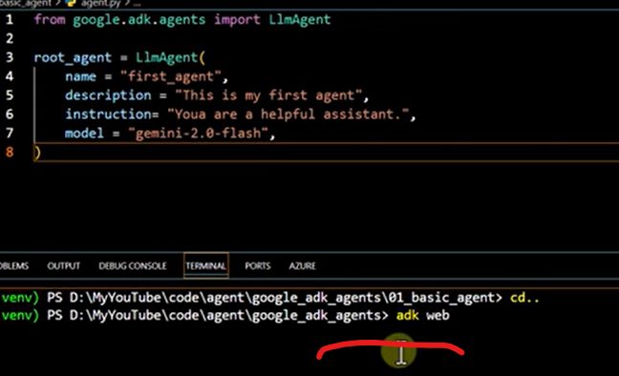
Import agent from startup.py

Slide 12
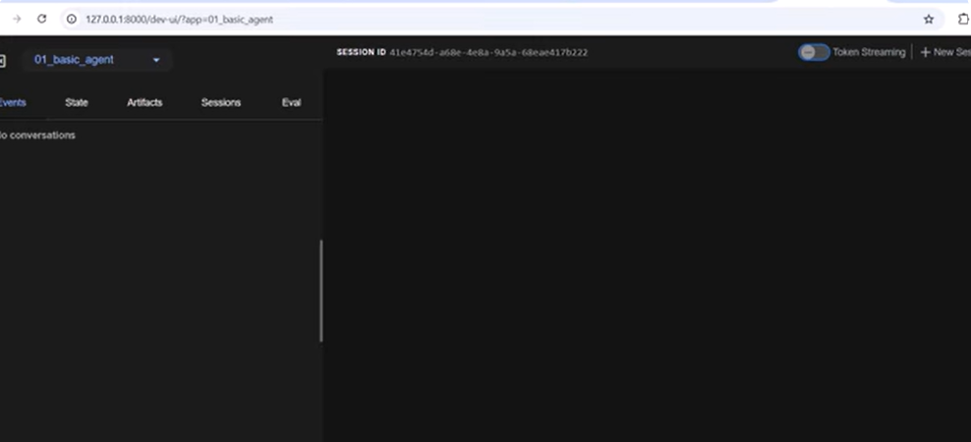
Run the Agent Final

Slide 13
